Slide 1
Mission Hall Updates
Ask & Learn
Christine Shaff
Luis Vite
UCSF Real Estate
Cristina Morrison
SOM Dean’s Office

Slide 2
Agenda
Reconfiguration and Renovation Updates
MH Moves: Near Term Assignments & Final state
Campus Construction & Chase Center grand opening
MH Zoom Training Sessions & Open House
Q&A

Slide 3
Reconfiguration & Renovation Updates
Renovations: As of Feb 2019, Focus rooms to Office conversions (230+) and acoustic panel improvements have been completed on Floors 2-7
  Focus Rooms must remain shared space for anyone on the floor. Contact your floor coordinator for questions on which rooms are focus rooms and offices.
Locks and office signs: Lock shop & facilities has been notified that locks and office signage will begin installation in Jan 2020 after Final State move is complete.
Electronic wayfinding touchscreen: to be completed on Floors 2-7 by the end of next week, June 7th
Reconfiguration- Floors 4-7 only
  January 15, 2019: AVC Lori Yamauchi and Vice Dean, Bruce Wintroub sent out updates to all chairs, administrative officers, and chiefs of all departments/units on Floors 4-7 regarding upcoming moves to prepare for PMCB bldg opening June & Block 33 opening in Jan 2020.
  April 30, 2019: Final State memo sent by Lori & Bruce along with map layouts.
  May 3, 2019: Near Term Assignment plan memo along with map layouts sent by Lori and Bruce

Slide 4
Near Term Assignments- “Interim Period”
May 2019-Q1 2020; only affects Floors 4-6
Preparation for Precision Cancer Medicine Building (PCMB) opening Summer 2019; faculty and staff moving from Mount Zion will need space in Mission Hall to support the work in PCMB.
Purpose: To vacate space for Mt Zion groups (100+ faculty/staff) while allowing current occupants to have officially assigned offices.
No group will be losing space
Growth space will be assigned in the Final state moves→ Q1 2020.
Please contact Adrian Miu, Luis Vite & Forrest Lewis for any move questions.

Slide 5
MH Final State
Q1 2020- Forward
Floors 4-7
Wayne and Gladys Valley Center for Vision and Valley Tower (CVN) opening Q1 2020; several groups currently in MH will move out which will release seats, creating growth space for us to distribute to current occupants and allow the rest of Mt Zion groups (150+ faculty/staff) to move in.
Main moves that will organize floors in MH by department, rather than the original model organized by Adults and Pediatric services.
Growth space will be provided to groups
Office locks and signs will be installed once Final State moves are complete.

Slide 6
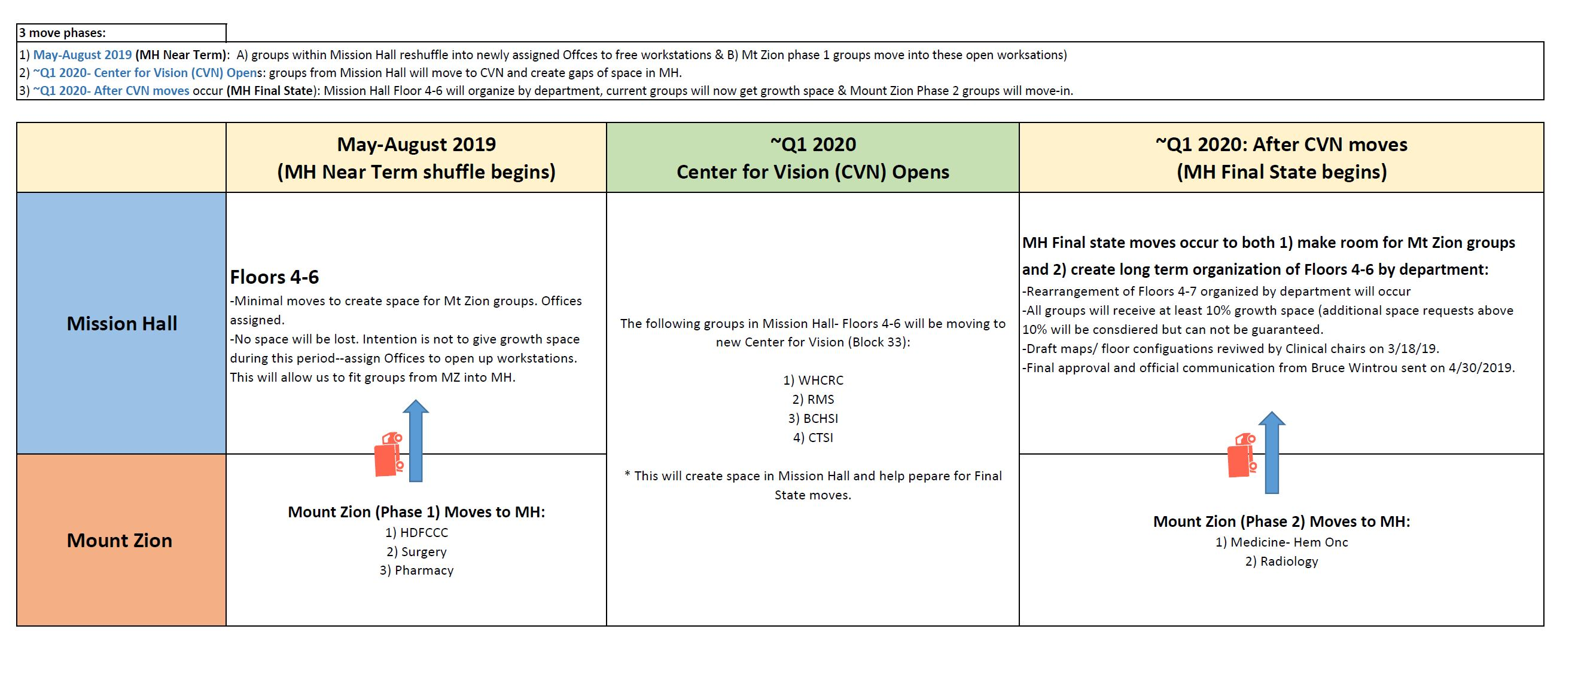
Visualized Move Plan

Slide 7
Other Mission Bay Construction
UCSF
  Weill Neurosciences Building, underground utilities
  PCMB and Wayne and Gladys Valley Center for Vision
Non-UCSF construction
  Muni stop at MB
  Other projects on 3rd Street
  Chase Center opens September 2019

Slide 8
Zoom Training Sessions & Open House
Increased need to provide training for current and new employees on using Zoom properly.
Agenda & Details will be posted on MH website and shared by Floors coordinators on each floor
Training Dates:
  Thursday June 20, 1-3 p.m. in MH 5700
  Friday June 28, 10-noon in MH 6500
  Thursday July 25, 10-noon in MH 6500

